Slide 1
Data Wrankling and Data Analysis
SQL-Structured Query Language

Slide 2
Index
Module 1: Getting Started and Selecting &Retrieving Data with SQL.
1.Define SQL and how SQL works.
2. SQL Mechanism
3. Table and SQL syntax
4.SQL Commands
5.Data Definition Language
6.Data Manipulation Language
7.Transaction control Language
8.One to one Relationship
9.One to many Relationship
10.Many to many Relationship
Module 2: Filtering, sorting and calculating the data with SQL
1.Operator and the description
2.How Operator Works
3.Clauses and operators
i. In, or, not, like, where, between, order by, group by
4.Math operators and Aggregate functions
i. Average, count, max, min
5. Wildcard Operators

Slide 3
Index
Module 3: Subqueries and joins in SQL
1.Subquries , Advantage and Disadvantage
2.Concept of key field
3.Define joins and types of joins.
4.Aliases and Pre-qualifiers
Module 4: Modifying and Analyzing Data with SQL
1.Modify Strings (Concatenating, trimming, changing case and using the substring function)
2.Date and Time strings.
3.Use case statements
4.Data governance and profiling
5.Fundamental Principles when using SQL for Data Science
6.Tips and Tricks to apply SQL in Data Science context
Module 5: SQL Problem Solving
Module 6: Case Study: AB testing

Slide 4
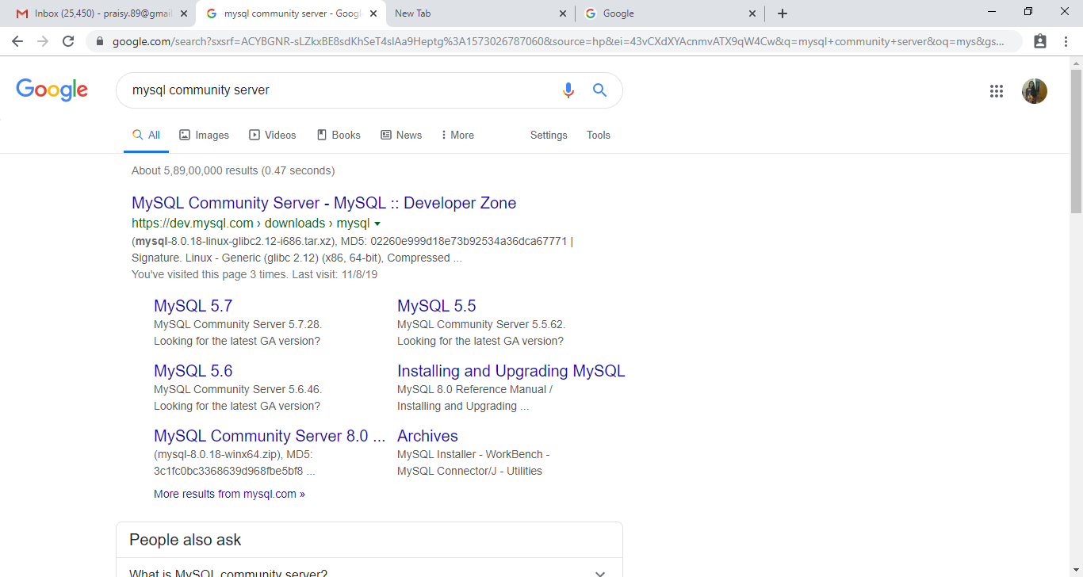
Installation of SQL Step1
Click on the first blog.
i.E MySQL community server.

Slide 5
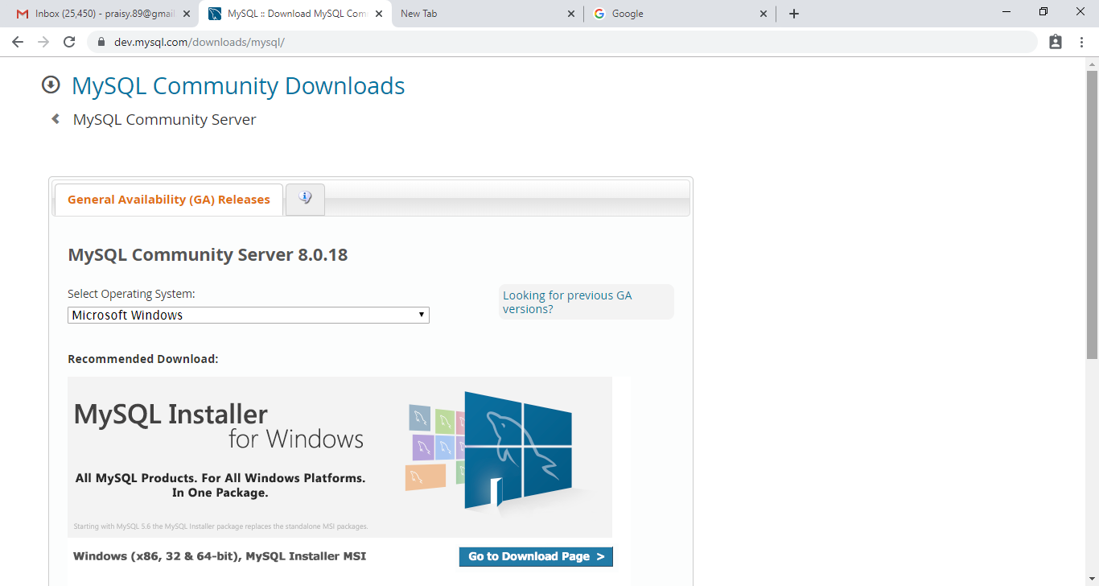
Step2
Click on to go to download option

Slide 6
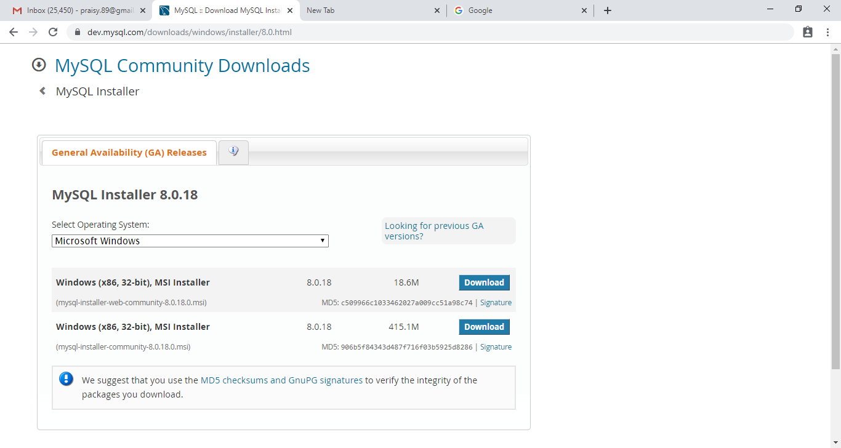
Step 3
Click on the first download option.

Slide 7
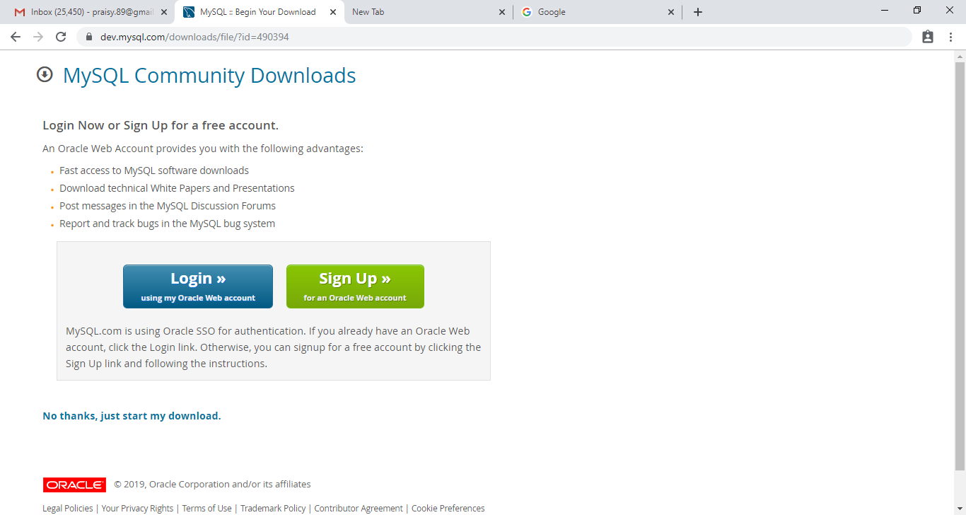
Step 4
Click on the , just start my download

Slide 8
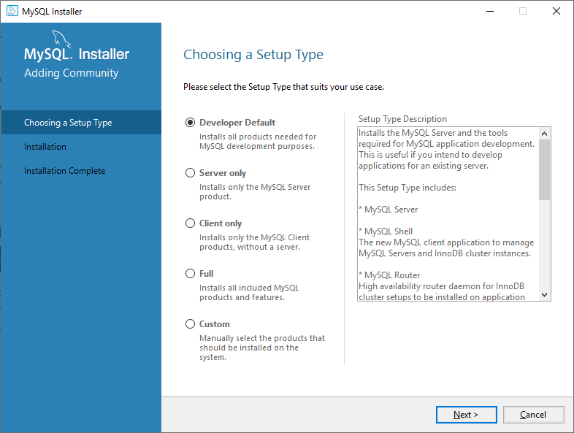
Step 5

Slide 9
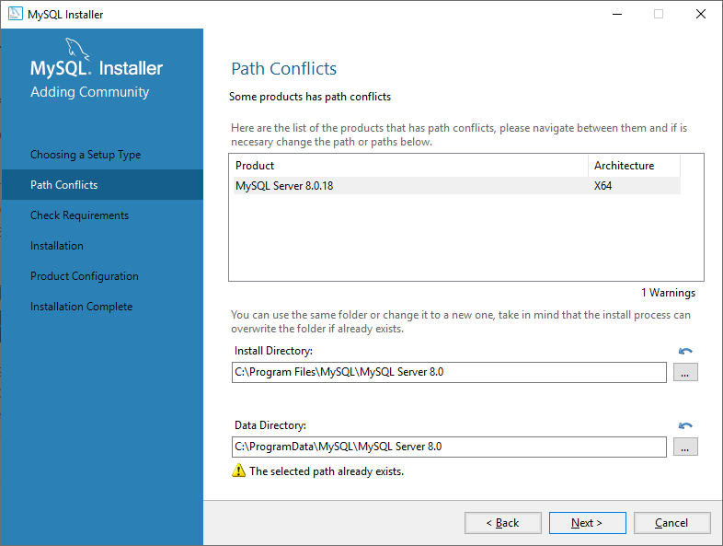
Step 6

Slide 10
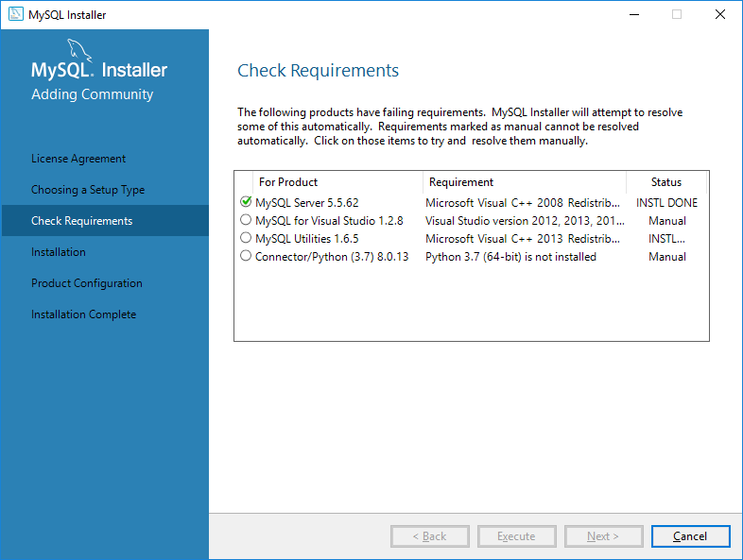
Step 7

Slide 11
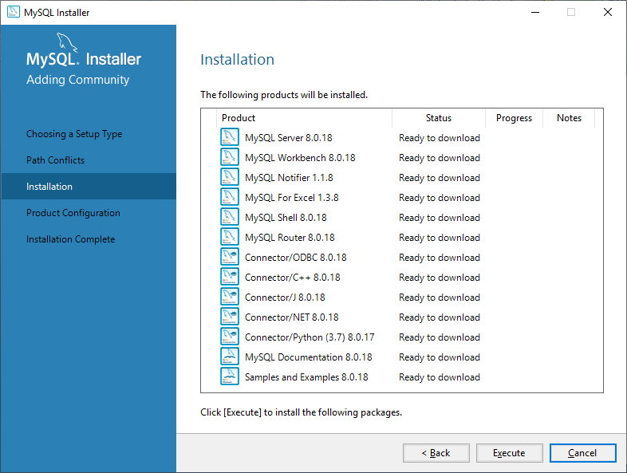
Step 8

Slide 12
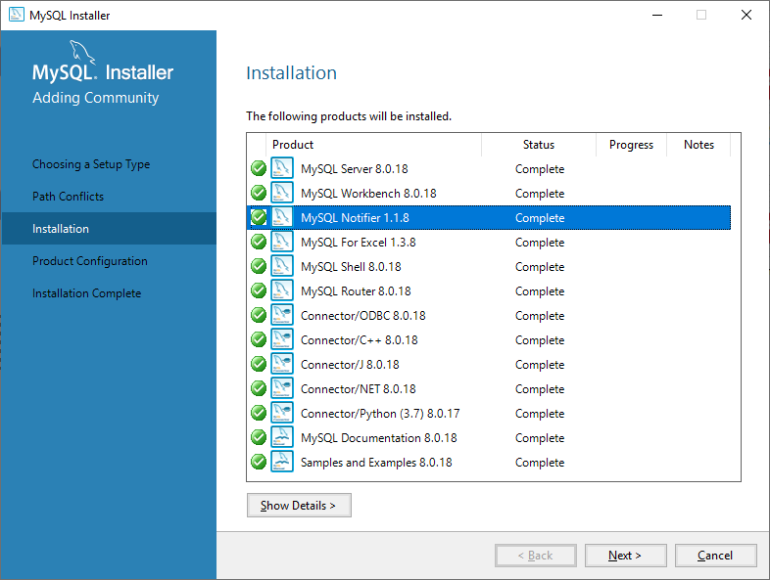
Step 9

Slide 13
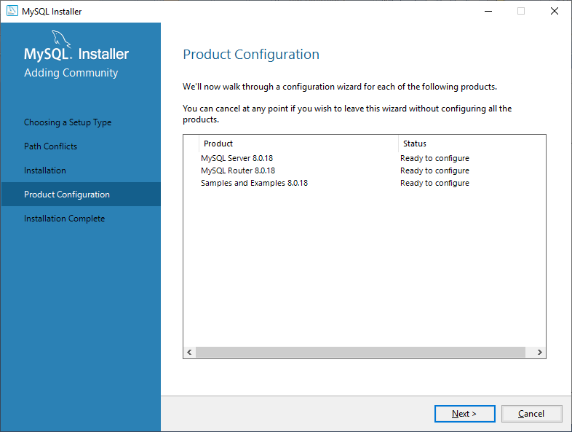
Step 10

Slide 14
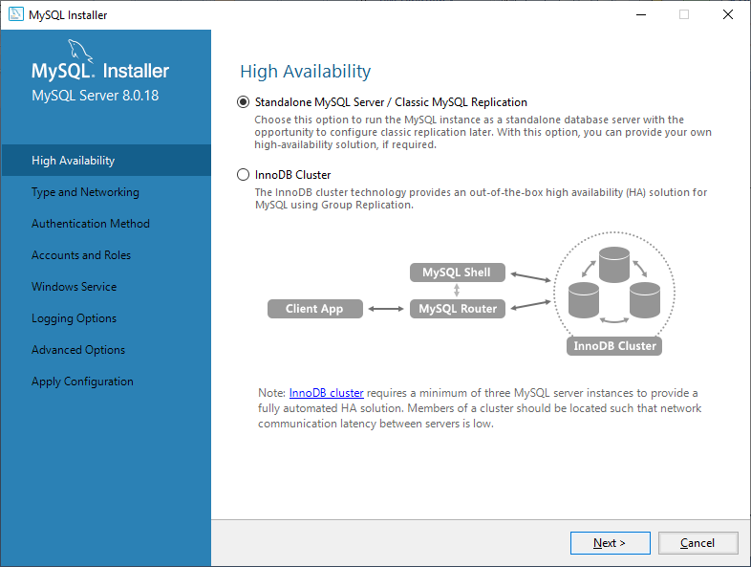
Step 11

Slide 15
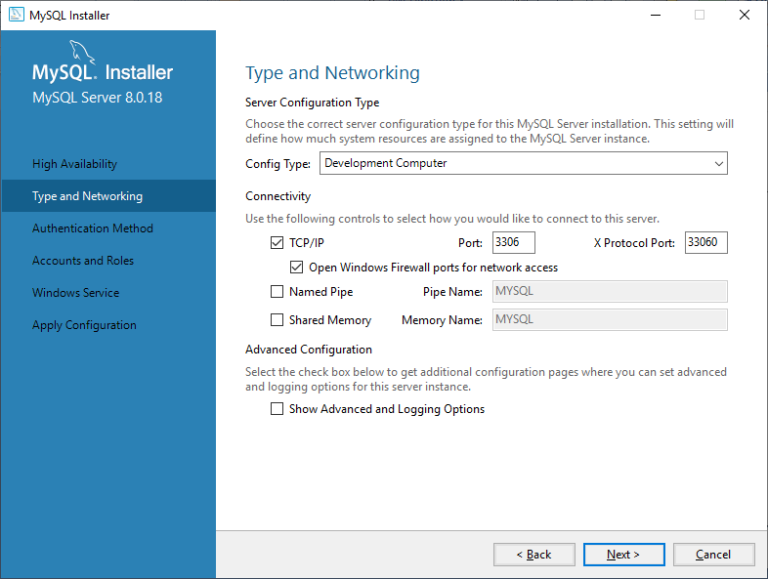
Step 12

Slide 16
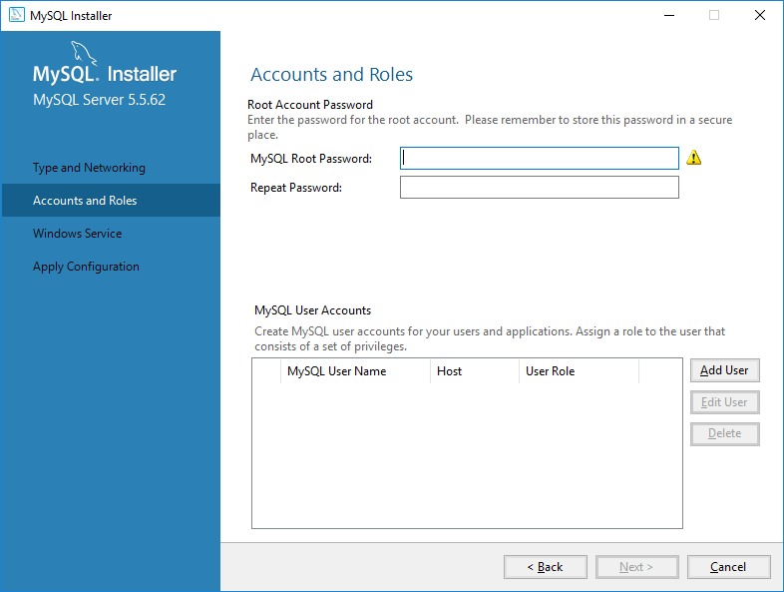
Step 13

Slide 17
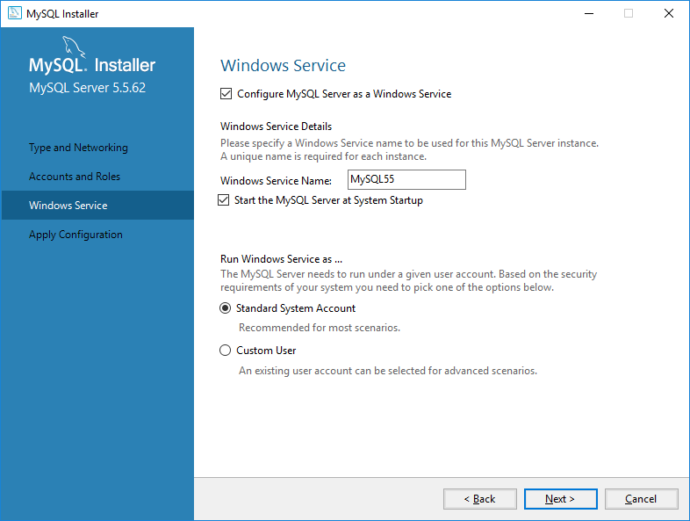
Step 13

Slide 18
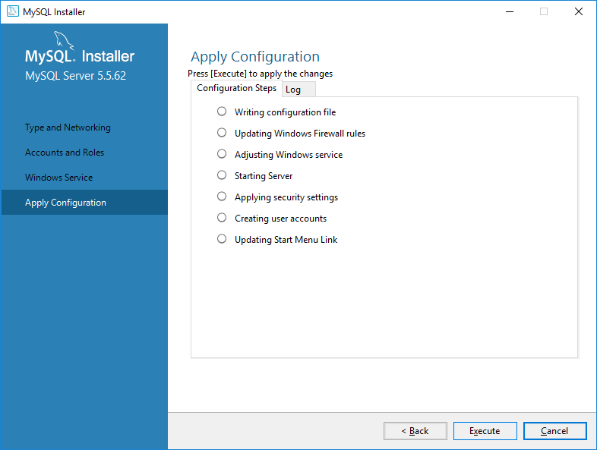
Step 14

Slide 19
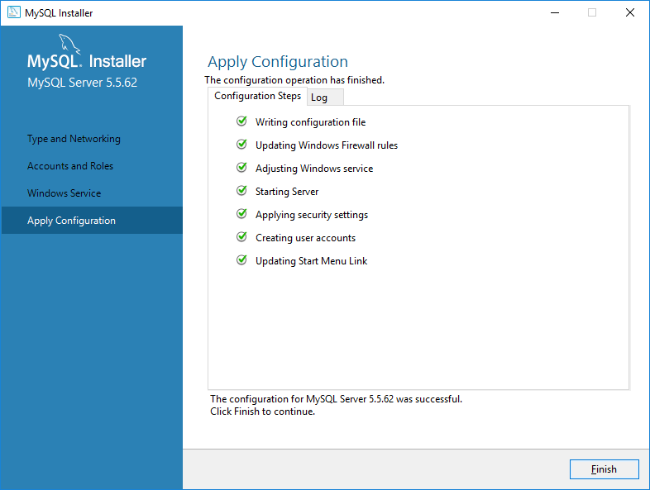
Step 15

Slide 20
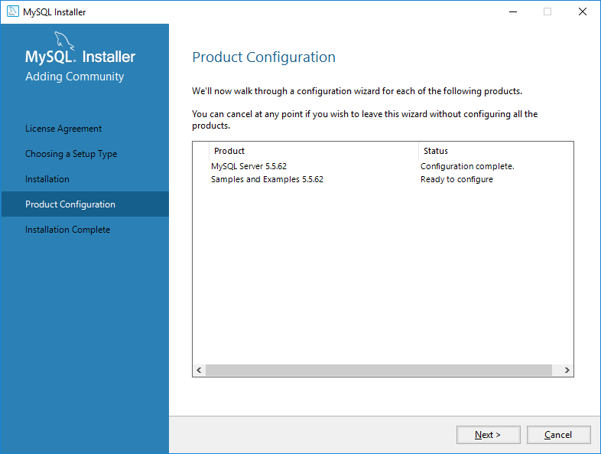
Step 16

Slide 21
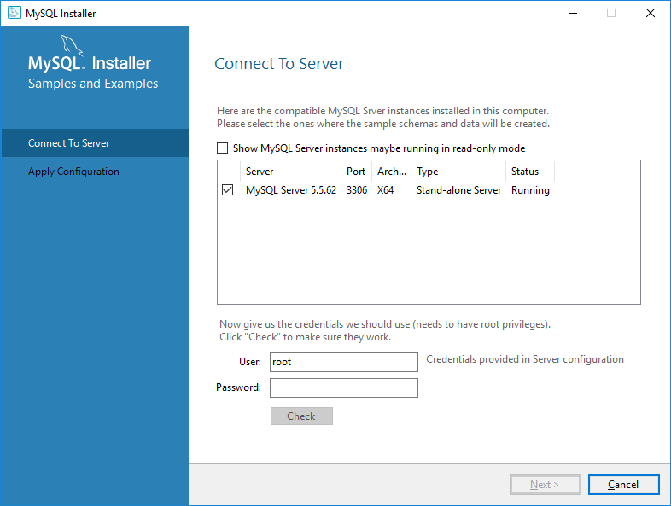
Step 17

Slide 22
Step 18

Slide 23
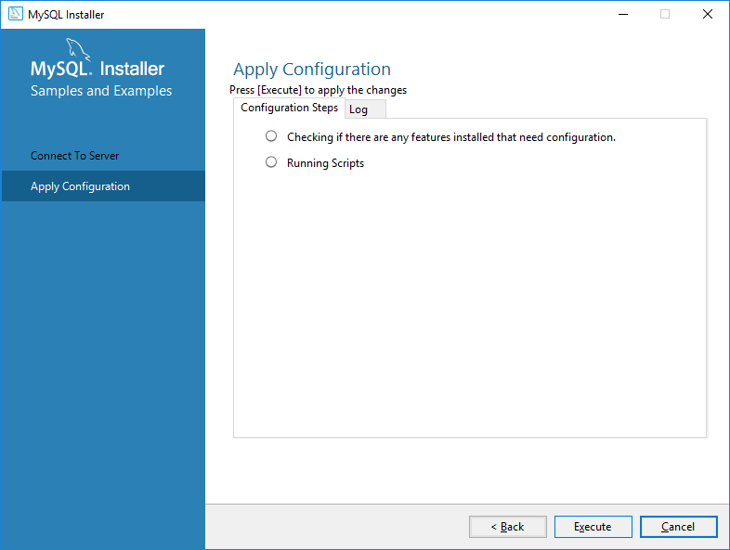
Step 19

Slide 24
Step 20

Slide 25
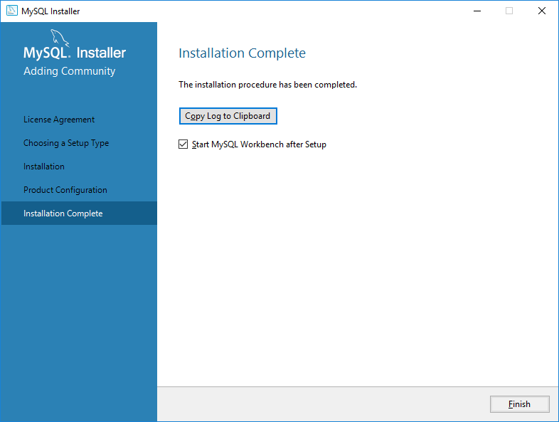
Step 21

Slide 26
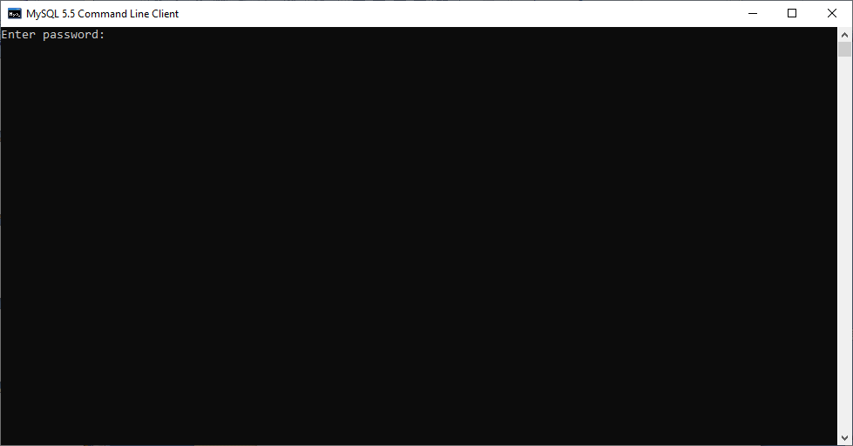
Step 22

Slide 27
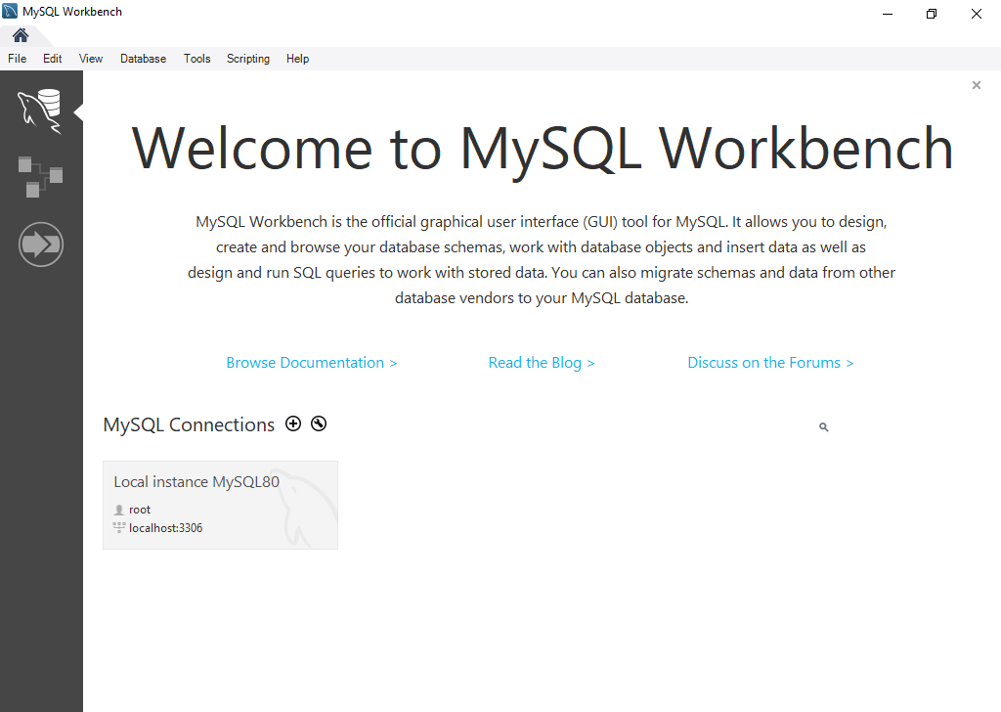
Step 23

Slide 28
Overview
What is SQL?
Why to learn SQL?
Brief history of SQL?
SQL Process
Prerequisites
Applications of SQL
What is RDBMS and its concepts?
Role of SQL in Datascience
General syntax
SQL commands

Slide 29
SQL Syntax
SQL MECHANISM
The Structured Query Language offers database users a powerful and flexible data retrieval mechanism — the SELECT statement. In this article, we'll take a look at the general form of the SELECT statement and compose a few sample database queries together.
The General Form of the SELECT Statement
The general form of the SELECT statement appears below:
SELECT select_list FROM source WHERE condition(s) GROUP BY expression HAVING condition ORDER BY expression

Slide 30
DDL-Data Definition Language
The data definition language commands are:
*CREATE- To create a table
*ALTER- To alter a table
*RENAME-To rename a table
*TRUNCATE-To delete the existing record in a table.

Slide 31
DML-Data Manipulation language
Data manipulation languages commands are:
*SELECT- To select or view the table .
*INSERT- To insert values in the table
*UPDATE-To update the existing record in a table
*DELETE- To delete the existing record in a table.

Slide 32
1.How to Create a table
*Syntax for creating a table:
Create table tablename (column1, column2….columnn);
2. How to insert values in the table?
*Syntax:
Insert into tablename values(value1,value2….value n);
Or other way to insert.
Insert into tablename(col1,col2..coln)values(val1,val2…valn);

Slide 33
3. How to view the table.
*Syntax:
Select * from tablename;
Note: if you want to select only the particular columns.
Then,
Select col1,col2 from tablename;

Slide 34
4.How to Rename a table?
*Syntax:
Rename tablename to tablename1;
5.How to delete complete data from an existing table?
*Syntax:
Truncate table tablename;

Slide 35
6.How to add a column in a table?
*Syntax:
Alter table tablename
Add columnname datatype;
7.How to drop a Column from a table?
*Syntax:
Alter table tablename
Drop columnname;

Slide 36
8.How to modify a column in a table
*Syntax:
Alter table tablename
Modify column columnname datatype;
9. How to update an existing record in a table?
*Syntax:
Update tablename set col1=value1 where
condition;

Slide 37
10.How to delete an existing record in a table?
*Syntax:
Delete from tablename where condition;

Slide 38
TCL-Transaction Control Language
TCL commands are:
(Select @@autocommit;)
Set autocommit=1;
*COMMIT- To save the changes
*ROLLBACK- To undo the transaction
*SAVEPOINT-To roll back to a certain point without rolling back the entire transaction.

Slide 39
How do we commit?
Set your code as select @@autocommit;
Set autocommit=0;
Syntax:
Commit;
How do we rollback?
Syntax:
Rollback;

Slide 40
How do we use Savepoint?
Syntax:
Savepoint savepoint_name;

Slide 41
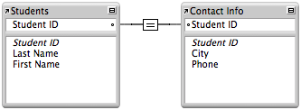
One to one Relationship
In a one to one relationship one record in the table is associated with one and only one record in another table.
Eg. In this example, the key field in each table, Student ID, is designed to contain unique values. In the Students table, the Student ID field is the primary key; in the Contact Info table, the Student ID field is a foreign key

Slide 42
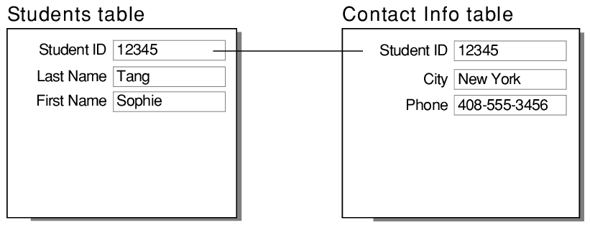
Example:

Slide 43
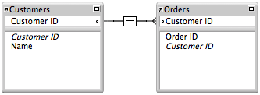
One to many Relationship
In a one-to-many relationship, one record in a table can be associated with one or more records in another table. For example, each customer can have many sales orders

Slide 44
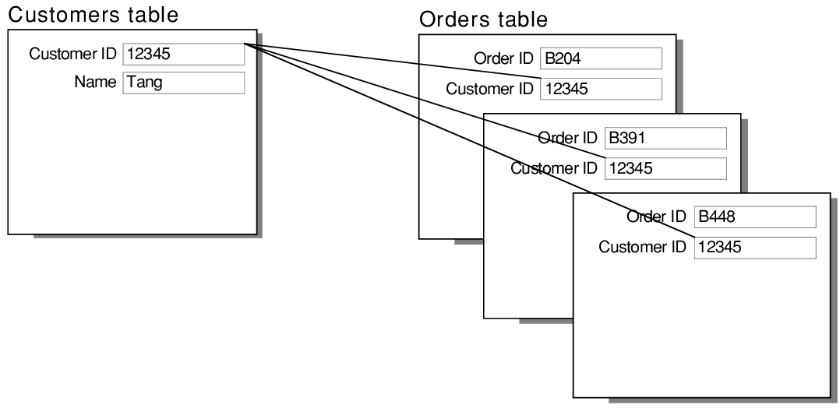
Example:
*In this example the primary key field in the Customers table, Customer ID, is designed to contain unique values. The foreign key field in the Orders table, Customer ID, is designed to allow multiple instances of the same value

Slide 45
Many to many Relationship
A many-to-many relationship occurs when multiple records in a table are associated with multiple records in another table. For example, a many-to-many relationship exists between customers and products: customers can purchase various products, and products can be purchased by many customers.

Slide 46
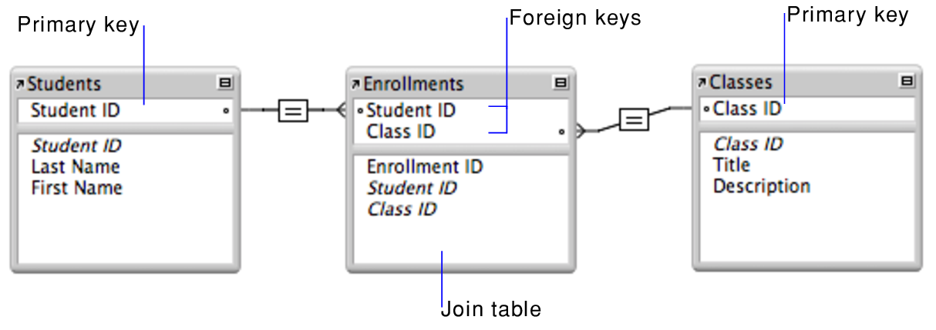
Example:
The primary key Student ID uniquely identifies each student in the Students table. The primary key Class ID uniquely identifies each class in the Classes table. The Enrollments table contains the foreign keys Student ID and Class ID

Slide 47
Exercise:
Create table any?
Insert values to the table
Do all the commands and run the querys.
Alter(add,drop ,modify), update, delete, commit,rollback,rename, savepoint.

Slide 48
Module 2 Filtering, sorting,calculating the data
1.Operator and the description
2.How Operator Works
3.Clauses and operators
i. In, or, not, like, where, between, order by, group by
4.Math operators and Aggregate functions
i. Average, count, max, min
5. Wildcard Operators

Slide 49
Module 2
Filtering sorting and calculating the data with sql
Basics of filtering with SQL
Learning objectives: Describe the basics of filtering your data.
Use WHERE clause with common operator
Use BETWEEN clause.
Explain the concept of null value.

Slide 50
Why filter?
1.Be specific about the data you want to retrieve.
2.Reduce the number of records you retrieve.
3.Increase query performance.
4.Reduce the strain on the client application
5.Governance limitation

Slide 51
Operator and description
Operator Description
= Equal to
<> Not equal
> Greater than
< Less than
>= Greater than equal to
<= Less than equal to
BETWEEN Between an inclusive range
NULL Is a null value

Slide 52
How Operator Works
Filtering on a single condition
Product name Unit price Supplier id
Tofu 23.5 6
Select Productname , unitprice from products where Productname= ‘Tofu’;

Slide 53
Filtering on a single value
Patient id Patient name Patient age Patient phn
P1 Priya 20 6567889
P2 Prem 26 876678
P3 Praisy 24 987655
Select Patientid, Patientname, Patientphn from Patient where Patientage < 26;
A.Priya n praisy has got ages less than 26.

Slide 54
Filtering with a range of values:
How between clause works:
Select Patientid, Patientname, Patientphn from Patient where Patientage between 20 and 30;
Ans: All the list will appear since the ages of the three lies in between 20 and 30.
Filtering no value
Select Patientid, Patientname from Patient where Patientid is null;

Slide 55
Different operator
IN OPERATOR
Specifies a range of conditions
Comma delimited list of values
Enclosed()
Syntax:
Select * from table_name where column_name IN(‘value 1’, ‘value2’);

Slide 56
IN operator examples
Select * from Student where Studname IN(‘Rinkal’, ‘Afsal’);
Ans: Entire details of Rinkal and Afsal will be displayed.

Slide 57
OR operator
DBMS will not evaluate the second conditions in a WHERE clause if the first condition is met.
Use for any rows matching the specific conditions

Slide 58
OR Operator syntax
Select * from table_name where column_name1>‘value’ or column_name2<‘value’;
Example:
Select * from Student where Studage >15 or Studmark <50

Slide 59
AND Operator
AND operator is used to combine multiple conditions
Specified with the WHERE clause. AND makes it necessary for all the conditions to be true.
Syntax:
Select * from Tablename where column_name1> ‘Value’ And column_name 2 >’Value’;
Example:
Select * from Student where Studmark >15 AND Studmark >50;

Slide 60
NOT Operator
The NOT operator displays a record if the condition(s) is NOT TRUE.
Syntax:
Select * from Tablename where not Column1> value;
Example:
Select * from Student where NOT age> 20;

Slide 61
LIKE Operator
The LIKE operator is used in a WHERE clause to search for a specified pattern in a column.
There are two wildcards often used in conjunction with the LIKE operator.
% The percent sign represents zero, one or multiple characters.
_ The underscore represents a single character
Syntax:
Select * from tablename where column LIKE pattern;
Select * from student where studname LIKE ‘M%’;
Ans: Studentname Mary details will be displayed from Student table.

Slide 62
ORDER BY
The ORDER BY keyword is used to sort the result-set in ascending or descending order.
The ORDER BY keyword sorts the records in ascending order by default . To sort the records in descending order, use the DESC keyword.
Syntax:
Select * from table name ORDER BY column1 ASC|DESC;
Example:
Select * from Student ORDER BY Studname;
Ans: The entire table of student will be arranged in ascending order

Slide 63
GROUP BY
The GROUP BY statement groups rows that have the same values into the summary rows like, “ find the number of customers in each country”.
The GROUP BY statement is often used with aggregate functions ( COUNT, MAX, MIN, AVG,SUM) to group the result –set by one or more columns.
Syntax:
Select Column_name(s) from Table_name GROUP BY column_name1, column_name2;
Example:
Select studid, studname from student group by studadd;

Slide 64
Math operators and aggregate functions
COUNT:
The COUNT() functions returns the number of rows that matches a specified criteria.
Syntax:
Select Count(column_name) from table_name where condition;
Example:
Select count(studid) from student where studname= ‘Rinkal’;
AVG:
The AVG() function returns the average value of a numeric column.
Syntax:
Select AVG(column_name) from table_name where condition;
Example:
Select AVG(Emppay) from emp;

Slide 65
Math operators and aggregate functions
SUM:
The SUM() function returns the total sum of a numeric column.
Syntax:
Select SUM(column_name) from table_name where condition;
Select SUM(Empage) from emp;
MAX:
The MAX() function returns the largest value of the selected column.
Syntax:
Select Max(Coulmn_name) from table_name where condition;
Example:
Select Max(Price) from food;

Slide 66
Math operators and aggregate functions
MIN:
The MIN() function returns the smallest value of the select column.
Syntax:
Select MIN(column_name) from table_name where condition;
Example:
Select MIN(Price) from food ;

Slide 67
Wild card operators
A wildcard character is used to substitute one or more characters in a string.
Wildcard characters are used with the SQL LIKE operator. The LIKE operator is used in a WHERE clause to search for a specified pattern in a column.

Slide 68
Table
Symbol | Description | Example
% | Represents 0 or more characters | bl % finds blue,black, blob.
_ | Represents a single character | h_t find hot, hat, hit
[] | Represents any single character within the brackets | h[oa]t finds hot and hat but not hit.
^carat - | Represents any character not in the bracket. Represents a range of characters | h[^oa]t finds hit ,but not hot and hat C[a-c]t finds cat and cbt,cct.

Slide 69
Wildcard operators
All the wild cards can also be used in the combinations. Here are few examples showing different LIKE operators with ‘%’ and ‘_’
LIKE operator | Description
WHERE CustomerName LIKE ’a%’ | Finds any value that starts with ‘a’
WHERE CustomerName LIKE ’%a’ | Finds any value that ends with ‘a’
WHERE CustomerName LIKE ’%ro%’ | Finds any value that have ‘ro’ in position.
WHERE CustomerName LIKE ‘_r%’ | Finds any value that have ‘r’ in the second position
WHERE CustomerName LIKE ‘a_%_%’ | Find any value that starts with ‘a’ and are atleast 3 characters in length.
WHERE CustomerName LIKE ‘a%o’ | Find any values that starts with “a” and ends with “o”.

Slide 70
Examples:
Select * from emp where Empname LIKE ‘Kee%’;
Select * from emp where Empdes LIKE ‘%or%’;
Select * from emp where Empname LIKE ‘a_%_%’;
Select * from emp where Empname LIKE ‘[a-c]%’;

Slide 71
Advantage of wildcard:
Can only be used with strings
Helpful for data scientists as they explore string variables
Matches a single character
Used to specify a set of characters in a specific location.

Slide 72
Disadvantage of wildcard
Cannot be used for non-text datatypes
It is not supported by DB2
Does not work with all DBMS
Does not work with SQLlite

Slide 73
Module 3 Subqueries and joins in SQL
1.Subquries , Advantage and Disadvantage
2.Concept of key field
3.Define joins and types of joins.
4.Aliases and Pre-qualifiers

Slide 74
What are Subquery?
Subqueries are queries embedded in queries. They are used to retrieve data from one table based on data in another table. They generally are used when tables have some kind of relationship.
Basic syntax:
SELECT * FROM t1 WHERE column1 = (SELECT column1 FROM t2);
Code Sample:
Find the name of the company that placed order 10290.
SELECT CompanyName
FROM Customers
WHERE CustomerID = (SELECT CustomerID FROM Orders WHERE OrderID = 10290);

Slide 75
Code Sample Explanation
The subquery can contain any valid SELECT statement, but it must return a single column with the expected number of results.
For example, if the subquery returns only one result, then the main query can check for equality, inequality, greater than, less than, etc. On the other hand, if the subquery returns more than one record, the main query must check to see if a field value is (or is NOT) IN the set of values returned.

Slide 76
Advantages
They allow queries that are structured so that it is possible to isolate each part of a statement.
They provide alternative ways to perform operations that would otherwise require complex joins and unions.
They are, in many people's opinion, more readable than complex joins or unions. According to the MySQL docs, “it was the innovation of subqueries that gave people the original idea of calling the early SQL ‘Structured Query Language.’”
MySQL subqueries can return a single value, single row, single column, or a table, which is a resultset containing one or more rows of one or more columns.

Slide 77
Disadvantages
A disadvantage is that you cannot modify a table and select from the same table within a subquery in the same SQL statement.
Subqueries also can take longer to execute than a join because of how the database optimizer processes them.

Slide 78
WHAT ARE JOINS?
A SQL join is a Structured Query Language (SQL) instruction to combine data from two sets of data (i.e. two tables).
Before we dive into the details of a SQL join, let’s briefly discuss what SQL is, and why someone would want to perform a SQL join
Consider the following tables:
Now, let us JOIN these two tables using the SELECT statement :
Select id, name, age, amount from customers, orders where customers.id= orders.Cust_id;
Result:
This will produce the result from both the tables:
Id, name, age and amount will be displayed.

Slide 79
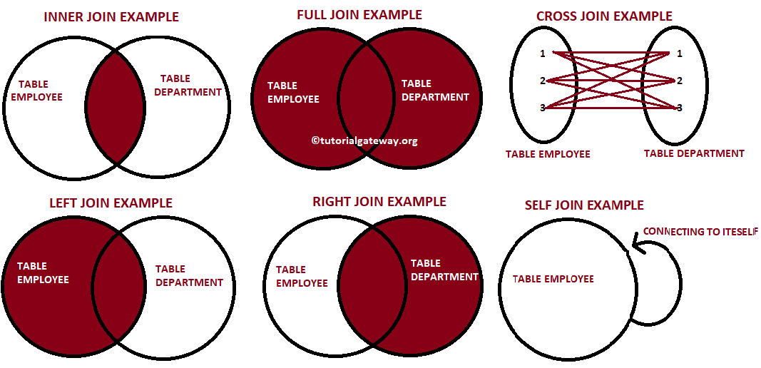
Pictorial Representation

Slide 80
DIFFERENT TYPES OF JOINS IN SQL
INNER JOIN:
The most important and frequently used of the joins is the INNER JOIN. They are also reffered as EQUI JOIN.
The INNER JOIN creates a new result by combining column values of two tables (table 1 and table 2) based upon the join- predicate. The query compares each row of table 1 with each row of table 2 to find all pairs of rows which satisfy the join –predicate. When the join-predicate is satisfied , column values for each matched pair of rows of A and B are combined into result row.

Slide 81
.LEFT JOIN:
The SQL LEFT JOIN returns all rows from the left table, even if there are no matches in the right table. This means that if the ON clause matches 0 (zero) records in the right table; the join will still return a row in the result, but with NULL in each column from the right table.
This means that a left join returns all the values from the left table, plus matched values from the right table or NULL in case of no matching join predicate.
Syntax:
SELECT table1.column1, table2.column2...FROM table1LEFT JOIN table2ON table1.common_field = table2.common_field;

Slide 82
3.RIGHT JOIN
The SQL RIGHT JOIN returns all rows from the right table, even if there are no matches in the left table. This means that if the ON clause matches 0 (zero) records in the left table; the join will still return a row in the result, but with NULL in each column from the left table.
This means that a right join returns all the values from the right table, plus matched values from the left table or NULL in case of no matching join predicate.
Syntax:
SELECT table1.column1, table2.column2... FROM table1 RIGHT JOIN table2 ON table1.common_field = table2.common_field;

Slide 83
4.FULL JOIN:
The SQL FULL JOIN combines the results of both left and right outer joins
The joined table will contain all records from both the tables and fill in
NULLs for missing matches on either side.
Syntax:
SELECT table1.column1, table2.column2... FROM table1 left join table2
ON table1.common_field = table2.common_field
Union all
SELECT table1.column1, table2.column2... FROM table1 right join table2
ON table1.common_field = table2.common_field;
Note: if database does not support Full join then mysql will also not support full join. In this case ,union all clause is used to combine the two joins.

Slide 84
5.SELF JOIN:
The SQL SELF JOIN is used to join a table to itself as if the table were two tables; temporarily renaming at least one table in the SQL statement.
This implies that each row in a table is joined with itself.
Syntax:
SELECT a.coulmn1 , b.column2
FROM table_name a, table_name b
WHERE some_condition;

Slide 85
6.CARTESIAN JOIN
The CARTESIAN JOIN is also known as CROSS JOIN. In a CARTESIAN JOIN there is a join for each row of one table to every row of another table. This usually happens when the matching column or WHERE condition is not specified.
In the absence of a WHERE condition the CARTESIAN JOIN will behave like a CARTESIAN PRODUCT . i.e., the number of rows in the result-set is the product of the number of rows of the two tables.
In the presence of WHERE condition this JOIN will function like a INNER JOIN.

Slide 86
Cartesian Join
Generally speaking, Cross join is similar to an inner join where the join-condition will always evaluate to True
Syntax:
SELECT table1.column1 , table1.column2, table2.column1...FROM table1CROSS JOIN table2;
For example:

Slide 87
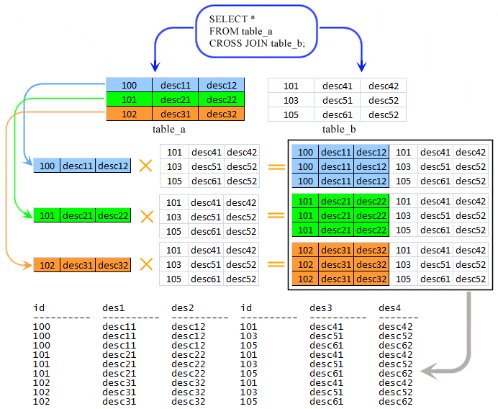
Pictorial representation of cross join

Slide 88
USAGE OF ALIASES
Learning Objectives:
Create aliases for use in our queries.
Discuss common naming conventions when using aliases.
Discuss and establish self-joins within a SQL Database.
What is an Alias?
SQL aliases give a table or a column a temporary name.
Make column names more readable.
An Alias only exists for the duration of the query

Slide 89
Syntax
Syntax:
Select column_name from table_name As alias_name;

Slide 90
Module 4 Modifying and Analyzing Data with SQL
How to modify strings by concatenating
*CONCAT()
The CONCAT() function adds two or more strings together.
Syntax: CONCAT(string1,string2,…….string_n)
Parameter values:
Parameter Description
String1,String 2….String_n The strings to add together.
Example:
Add 3 strings together.
Select CONCAT(‘ SQL ’, ‘ is ’, ‘ fun! ’);
Result:
SQL is fun!

Slide 91
Contd
How to modify strings by Trimming
*TRIM()
The TRIM() function removes the space character OR other specified
characters from the start or end of a string.
By default, the TRIM() function removes leading and trailing spaces
from a string.
Syntax:
TRIM([ characters FROM ] string)
Parameter values:
Parameter Description
Characters FROM Optional. Specific characters to remove
String Required. The string to remove spaces or characters from
Example:
Remove leading and trailing spaces from a string.
Select TRIM(‘#!’ ‘ FROM ‘ #HELLO SQL! ‘)As TrimmedString;
Result:
HELLO SQL

Slide 92
Date and Time strings
*CURRENT_TIMESTAMP
The CURRENT_TIMESTAMP function returns the current date and time, in a 'YYYY-MM-DD hh:mm:ss.mmm' format.
Syntax:
Current_timestamp;
Example:
Return the current date and time:
Select CURRENT_TIMESTAMP;
Result:
The current time and date will be displayed.

Slide 93
Different Date functions
*DATEADD()
The DATEADD() function adds a time/date interval to a date and then returns the date.
Syntax:
DateAdd(interval, number, date)
Example 1:
Add one year to date, then return the date.
Select DATEADD(year, 1, ‘2017/08/20’) As DateAdd;
Result :
2018/08/20

Slide 94
Contd..
Example 2:
Add two months to a date, then return the date
Select DateAdd(month, 2, ‘2018/06/23’) As DateAdd;
Result:
2018/08/23

Slide 95
*DATEDIFF()
The DATEDIFF() function returns the difference between two dates.
Syntax:
DateDiff(interval, date1, date2)
Example:
Return the differences between two date values in years.
Select DATEDIFF(year, '2017/08/25', '2011/08/25') AS DateDiff;
Result:
-6

Slide 96
*DATEFROMPARTS()
The DATEFROMPARTS() function returns a date from the specified parts
(year, month, and day values).
Syntax:
DATEFROMPARTS(year, month, day)
Example:
Return a date from its parts
Select DATEFROMPARTS(2018, 10, 31) AS DateFromParts;
Result:
2018-10-31

Slide 97
*DATENAME()
The DATENAME() function returns a specified part of a date.
This function returns the result as a string value.
Syntax:
DATENAME(interval, date)
Example:
Return a specified part of a date:
Select DATENAME(year, '2017/08/25') AS DatePartString;
Result:
2017.

Slide 98
*DATEPART()
The DATEPART() function returns a specified part of a date.
This function returns the result as an integer value.
Syntax:
DATEPART(interval, date)
Example:
Return a specified part of the date
Select DATEPART(day, '2017/08/25') AS DatePartInt;
Result:
25

Slide 99
*DAY()
The DAY() function returns the day of the month (from 1 to 31) for a specified
date.
Syntax:
DAY(date)
Example:
Return the day of the month for a date:
Select DAY('2017/08/25') AS DayOfMonth;
Result:
25

Slide 100
*GETDATE()
The GETDATE() function returns the current database system date and time, in a 'YYYY-MM-DD hh:mm:ss.mmm' format.
Syntax:
GETDATE()
Example:
Return the current database system date and time:
Result:
2019-10-10 10:17:47.927

Slide 101
*ISDATE()
The ISDATE() function checks an expression and returns 1 if it is a valid date,
otherwise 0.
Syntax:
ISDATE(Expression)
Example:
Check if the expression is a valid date:
Select ISDATE('2017-08-25');
Result:
1

Slide 102
*MONTH()
The MONTH() function returns the month part for a specified date (a number from
1 to 12).
Syntax:
Month(date);
Example:
Return the month part of a date:
Select MONTH(‘2017/08/25’) As Month;
Result:
8

Slide 103
*SYSDATETIME()
The SYSDATETIME() function returns the date and time of the computer where the SQL Server is running.
Syntax:
SYSDATETIME()
Example:
Return the date and time of the SQL server:
Select SYSDATETIME() As sysdatetime;
Result:
10/10/2019

Slide 104
*YEAR()
The YEAR() function returns the year part for a specified date.
Syntax:
Year(date);
Example:
Return the year part of a date:
Select year(‘2017/08/25’) As year;
Result:
2017

Slide 105
SQL Case statement
The CASE statement goes through conditions and returns a value when the first condition is met (like an IF-THEN-ELSE statement). So, once a condition is true, it will stop reading and return the result. If no conditions are true, it returns the value in the ELSE clause.If there is no ELSE part and no conditions are true, it returns NULL.
Syntax:
CASE WHEN condition1 THEN result1 WHEN condition2 THEN result2 WHEN conditionN THEN resultN ELSE result END;

